Slide 1

Technology of War - Database
Created by - Lakshmi Pachipulusu and Shravani Bhujbal
Notes:
Hi, this is an awareness project of our Database. This database includes the technology that was used in wars like weapons.

Slide 2
SAMPLE CONTENT OF OUR DATABASE

Slide 3
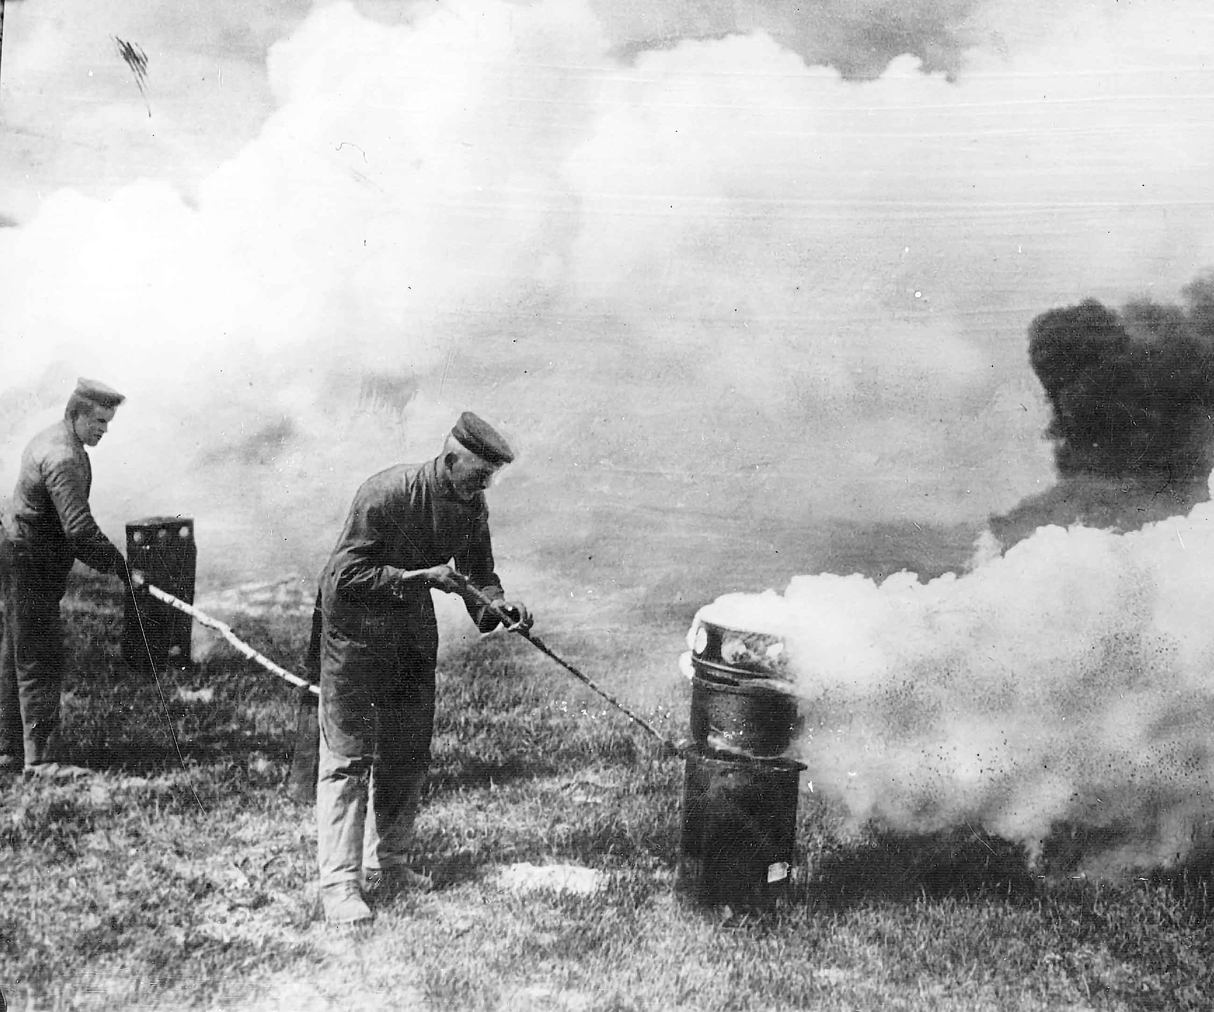
Poison Gas
At first, gas was just released from large cylinders and carried by the wind into nearby enemy lines. Later, phosgene and other gases were loaded into artillery shells and shot into enemy trenches. Mostly, there were gasses like mustard gas, that could kill by blistering the lungs and throat if inhaled in large quantities.
Poison gas was one of the most power war technology that was created, based on this there were many other inventions that were made, like the nuclear bombs.
https://www.rferl.org/a/history-of-chemical-weapons/29184063.html
Notes:
This is one peice of sample of the technology used in wars. Posion gas was largly used in wars. It is one of the most powerful war technology that was created.

Slide 4
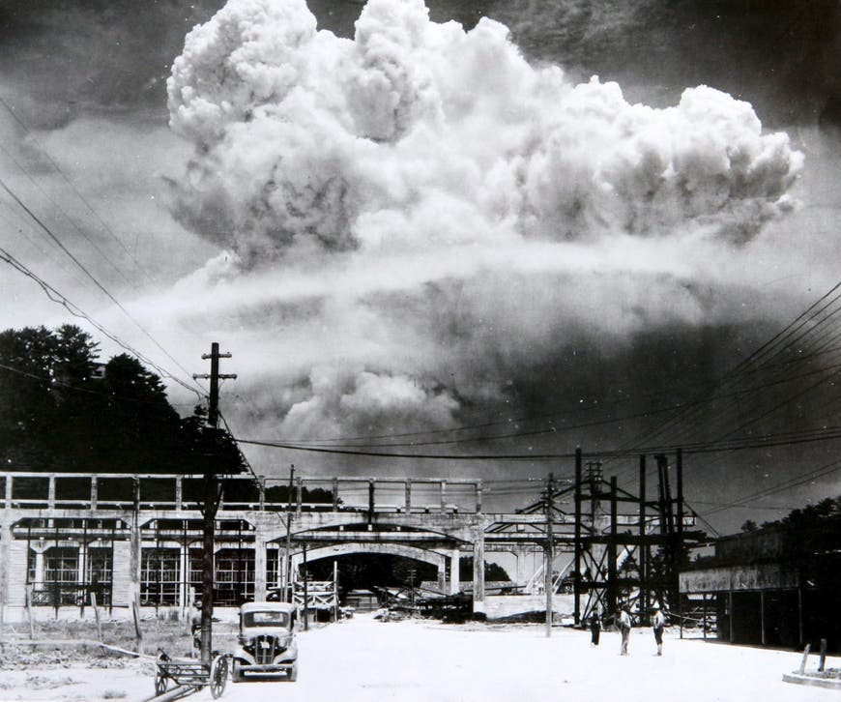
Nuclear Weapons
Nuclear bombs were the most destructive war technology that mankind had ever invented. It is very powerful and destructive. This nuclear weapon was first created by the physicists working on the Manhattan Project during World War II.
Nuclear bombs were one of the world’s most powerful war technology, like this there were other technology invented based on the Nuclear bombs such as hydrogen bomb, etc.
https://www.independent.co.uk/news/world/politics/nine-countries-have-nuclear-weapons-a6798756.html

Slide 5
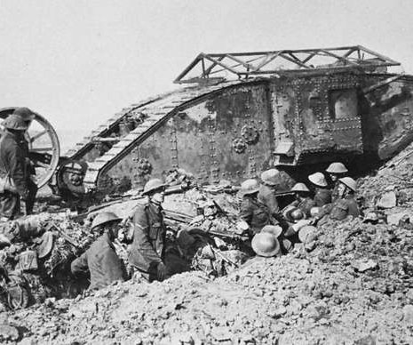
Tanks
These were heavily armed and armored combat vehicles. These were very protective and are used in wars. There could also be guns that can be carried inside the tanks.
Tanks were a very useful technology that was used for military purposes. Based on the tanks from the past, they also created new tanks with advanced technology.
https://www.britannica.com/technology/tank-military-vehicle/Interwar-developments

Slide 6
FEATURES OF OUR DATABASE

Slide 7

SMART SEARCH
Uses machine learning to recommend pages to the user based on previous search.
Uses optimization algorithms to filter the database to make the search quicker.
www.ie.edu/exponential-learning/blog/data-science/machine-learning-marketing/

